Slide 1
ANY2ANY: Trends in Multimodal Models
Haochun Tang
Supervisor: Prof. Enyan Dai

Slide 2
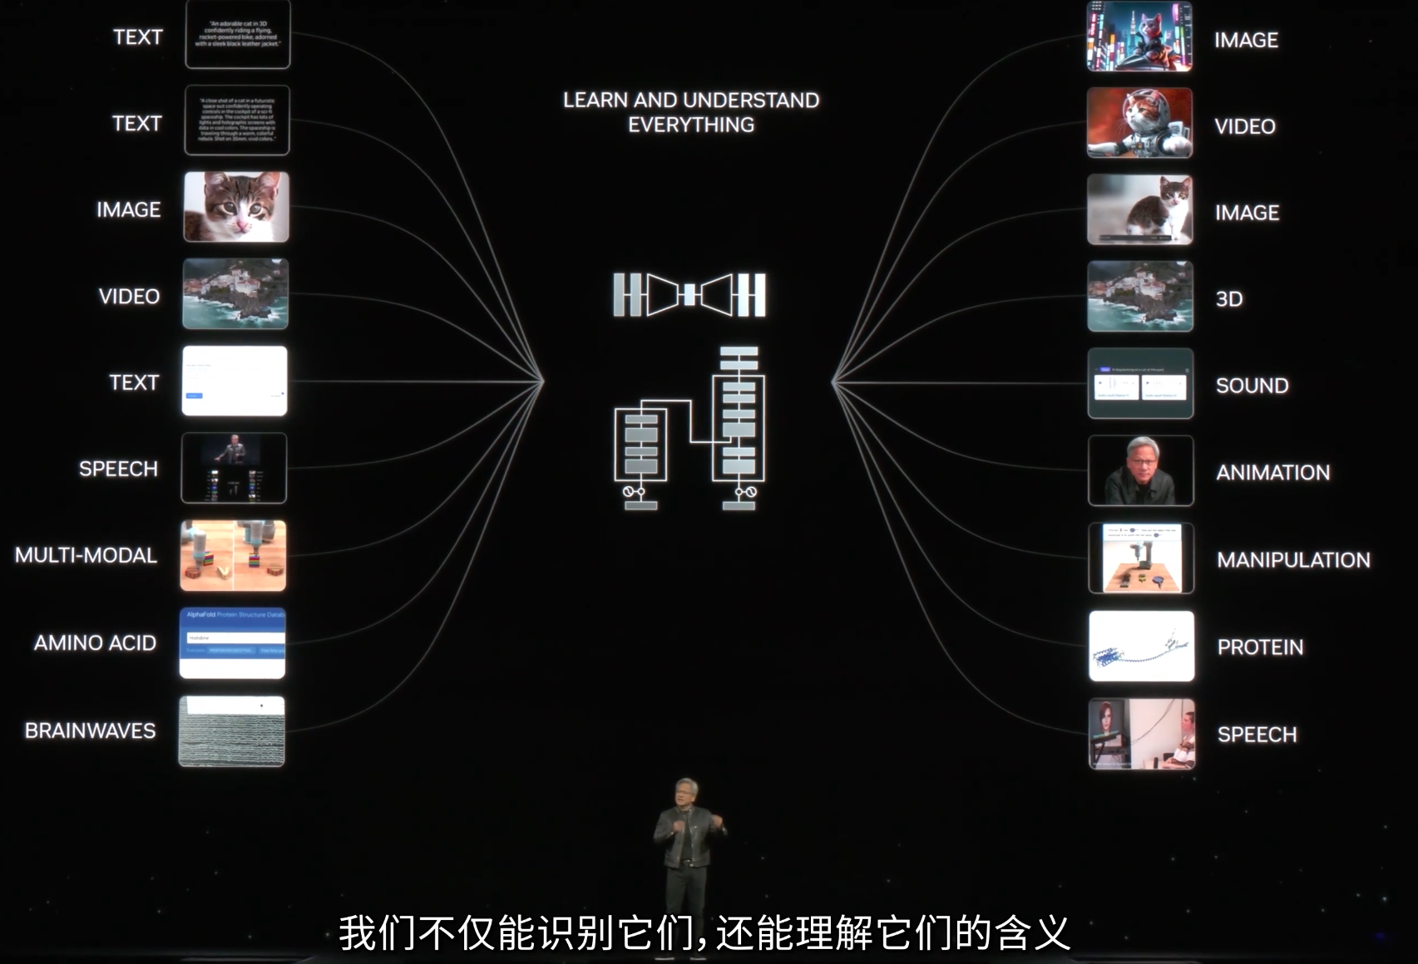
Introduction
Mulitimodal
Receive
Produce
Notes:
Human-level AI OR AGI
n GTC 2024, Jensen Huang introduced the concept learning but truly understanding multimodal inputs—ranging from text, video, and even brainwave signals.
The goal is to create an AI capable of both receiving and producing complex multimodal content seamlessly.
Some one would ask is it necessary to form a big model to do everything it seems like to create a big rocket by ellon mask it is easy to get a complex Composed of several components but the bigger one is cheaper and promising

Slide 3
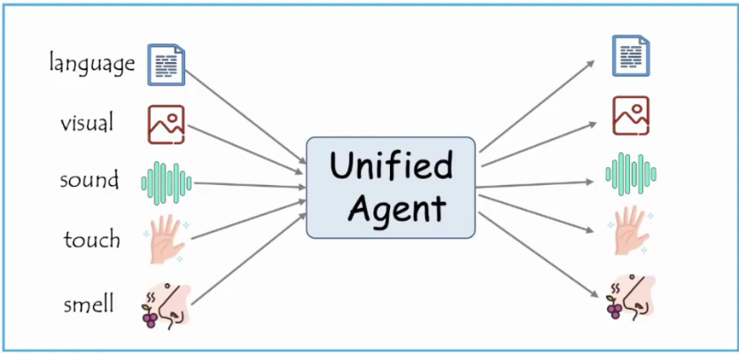
Introduction
“Alone we can do so little; together we can do so much.” – Helen Keller
>🌋 LLaVA
* Connect a vision encoder and LLM by a linear layer.
> Video-LLaMA
* Empower frozen LLMs with the capability of understanding both visual and auditory content in videos by adapter layer, Q-Former.
> PandaGPT
* Leverage multimodal encoders from ImageBind to enable large models to understand six modalities.
Key:How to align data
Notes:
关键的区别在于如何对齐不同模态的数据
本质上只是一种AGENT的变种 boring & normal
也就是说实际上还是使用了LLMS+DIFFUSION （late-fusion）
人们想要在这个基础上更进一步

Slide 4
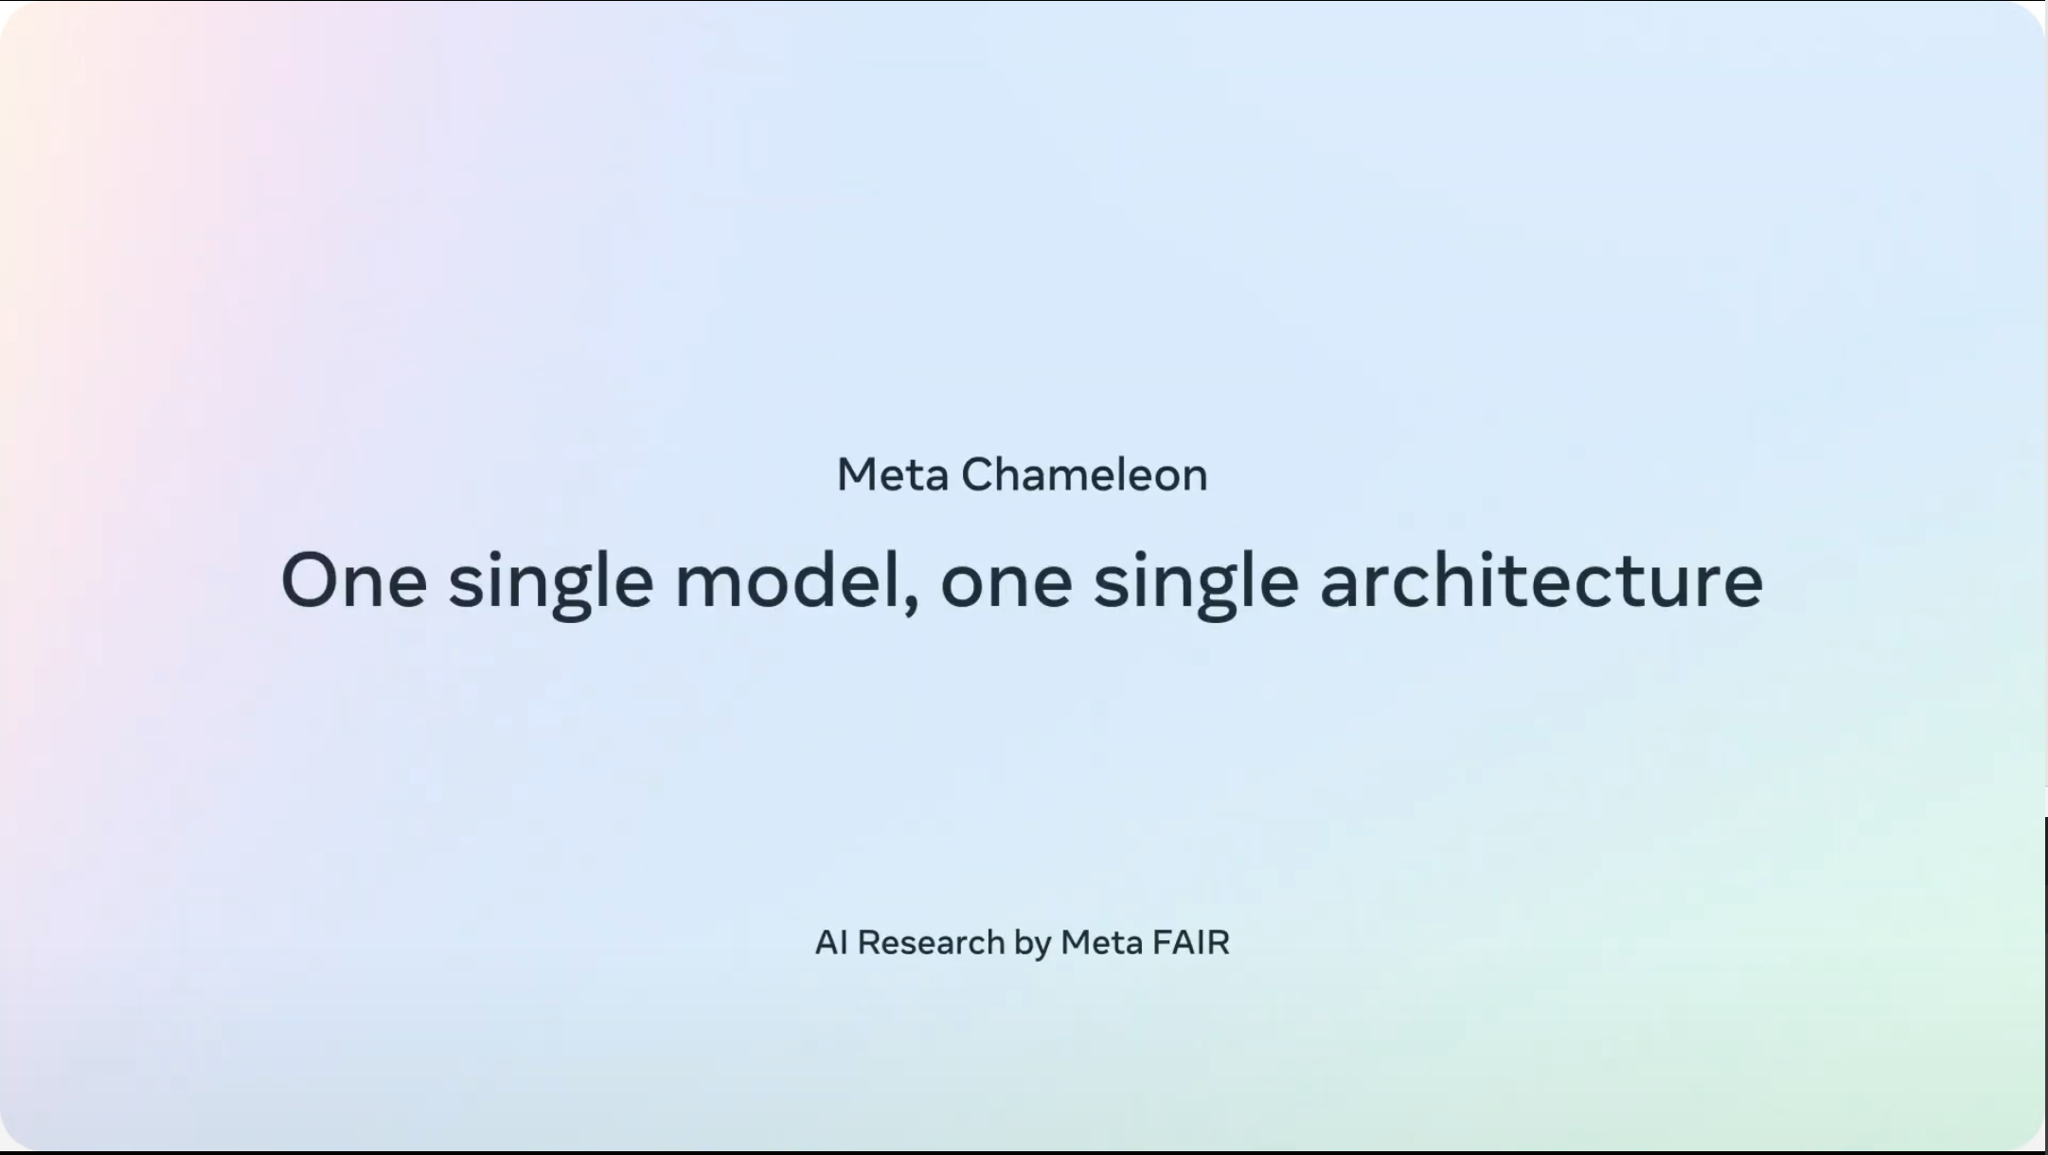
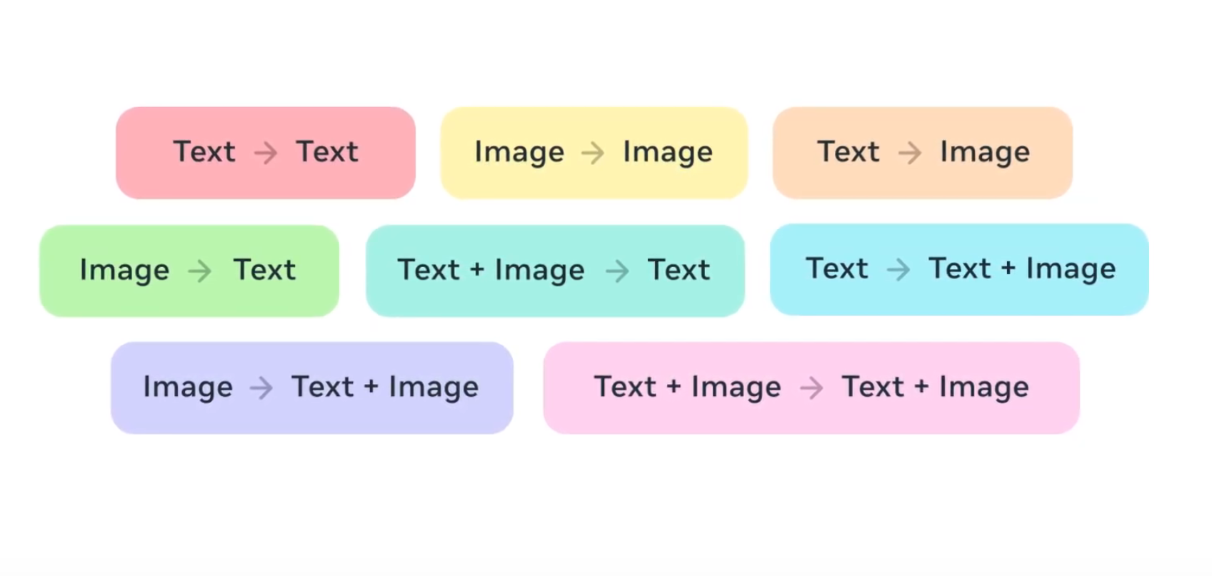
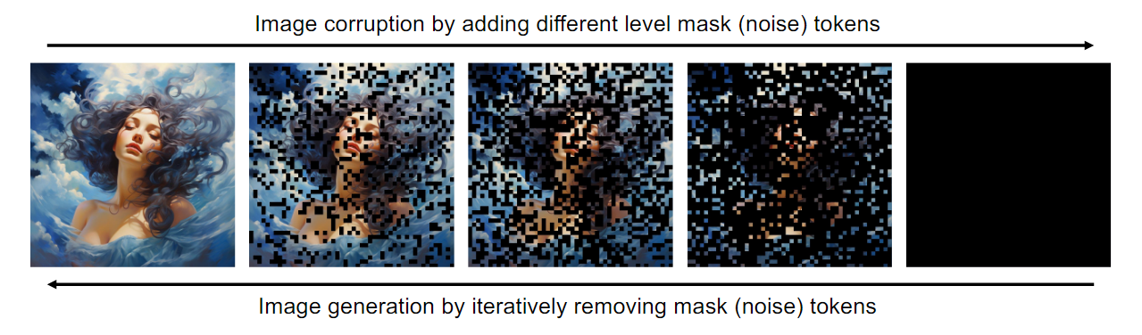
Introduction
Comparison
Ⅰ Understanding
Ⅱ Generation
Autoregressive Based
Diffusion Based
Features Projecting
Continuous/Discrete
VAE/VQ-VAE
LLaVA, miniGPT-4
Stable Diffusion3/ D3PMs
Notes:
Chameleon aims to unify understanding and generation, but it's not straightforward. As we compare these tasks, understanding typically uses autoregressive models that focus on how to project features effectively. On the other hand, generation is mainly diffusion-based, utilizing both continuous and discrete forms, with diffusion models iteratively refining outputs from noise to create images. This highlights the complexity in integrating these two aspects within a single architecture.

Slide 5
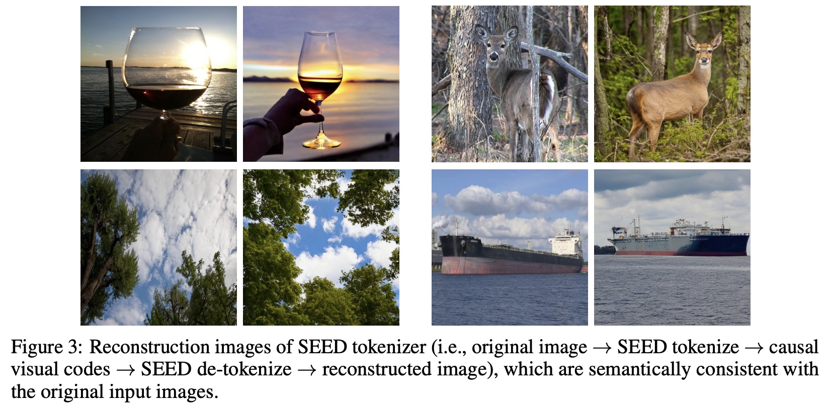
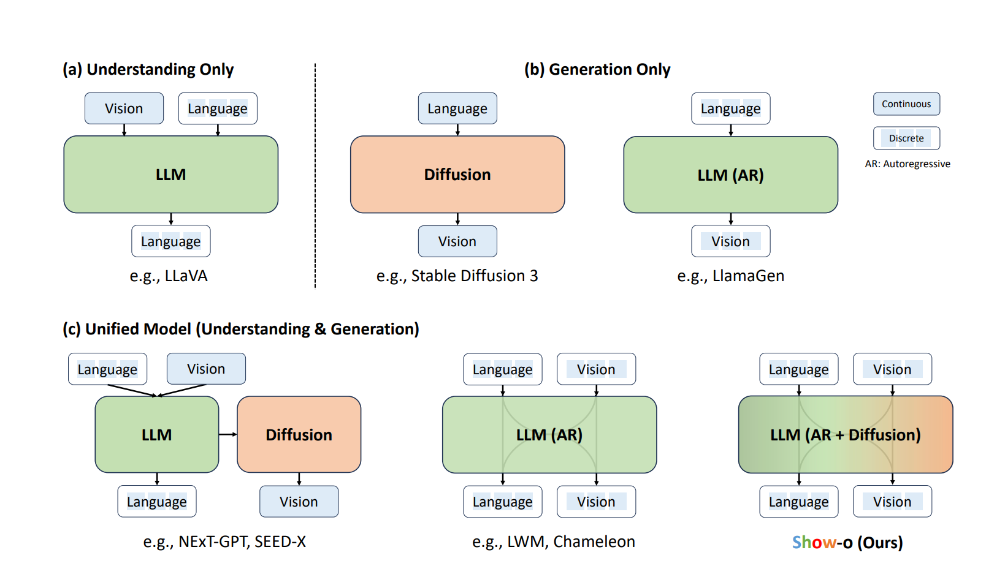
Introduction
Transformer
LLavA
StableDiffusion
.......
flexible sampling
generating diverse
detailed images
Different loss
codebook token
symbolic tasks
structured images
Same loss
Show-o: One single transformer to unify multimodal understanding and generation
Notes:
Show-o这篇文章中将上述的理解和生成任务划分为一下几类 他们发现现有的理解和生成模型都有基于transformer且表现较好的架构使用单一transformer并且将理解和生成同一起来
Challenge:How to encode the vision data?
Continuous: high quality
Discrete: the same loss the next token loss
Sota model like ST3 used the continuouse to avoid the loss of information
To see this more clearly, refer to the SEED paper's reconstruction results:(a common used Discrete Tokenizer)although the reconstructed images are clear and retain the overall semantics, the local details differ significantly.
This makes it unsuitable for arbitrary multimodal tasks like OCR.This is a big question and following paper would analysis such things in ablation study

Slide 6
Outline
AR Based
Chameleon
Emu3
AR & Confusion Based
Transfusion
Show-o
Notes:
Two kinds and 4 models would be introduced during this meeting.

Slide 7
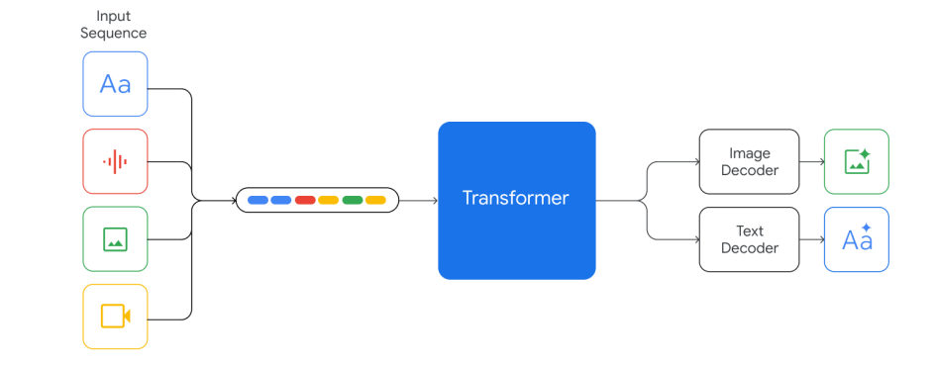
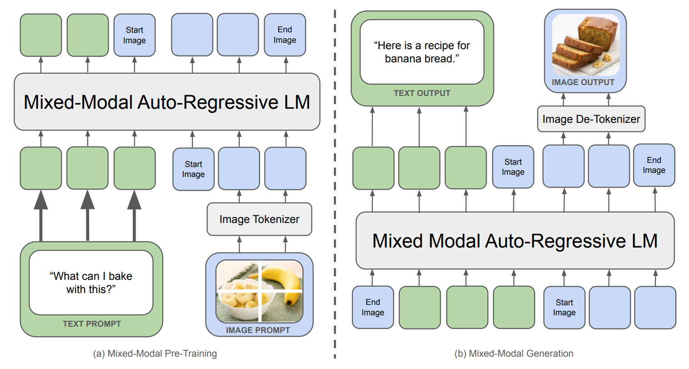
Chameleon(META)
Arch
Early Fusion: all modalities are projected into a shared representational space from the start.
Token-Based :quantizing images into discrete tokens, analogous to words in text.
End 2 End(Dense):apply the same transformer architecture, without the need for separate image/text encoders
Notes:
Text tokens are represented in green and image tokens are represented in blue.
Compared to other multimodal models like GPT-4-v, Chameleon uses a simpler approach.
Chameleon is not the only model using early fusion; Gemini also employs this approach. However, Gemini still uses different decoders, similar to an early exit strategy, and their decoder weights are not shared. In contrast, Chameleon is the first model to share weights across decoders.
It employs VQGAN's encoder for tokenizing images and its decoder for reconstruction, processing image and text tokens together, with shared weights being the key feature.
The key difference lies in shared weights.Gemini 使用了一个更灵活的策略，尤其是在图像生成过程中。它引入了类似于 early-exit 的机制，这意味着在生成图像时，模型可以更早退出生成过程，依赖于图像的复杂性或分辨率。这使得模型在某些生成任务中能够更高效地进行图像解码。

Slide 8
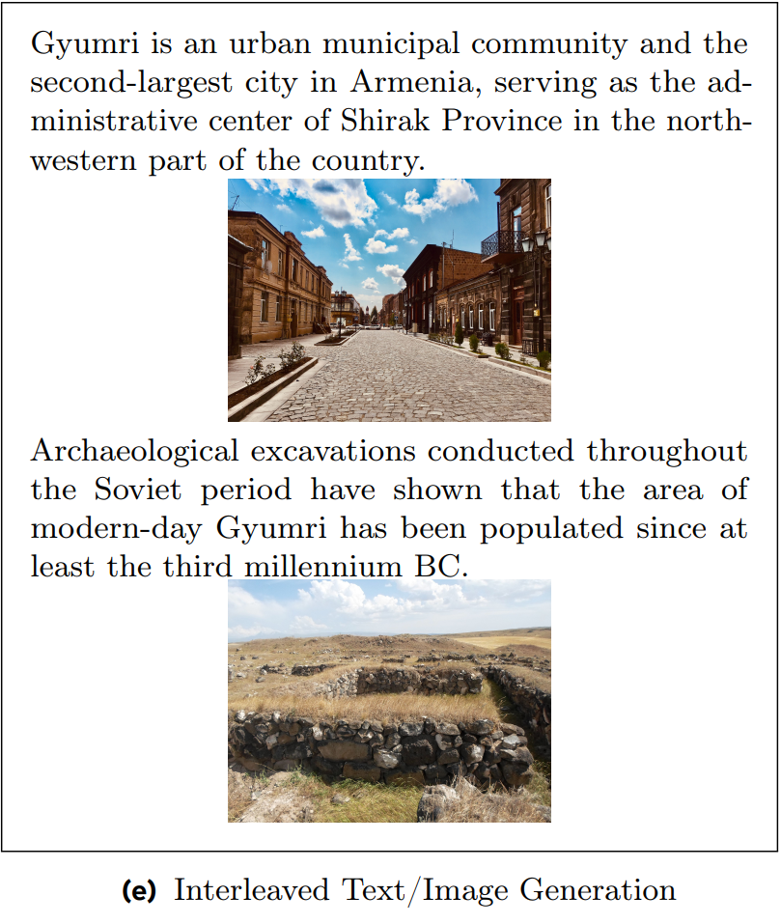
Chameleon
Pre-Training
Image Tokenization: encodes a 512 ×512 image into 1024 discrete tokens from a codebook of size 8192
Tokenizer: new BPE(Byte Pair Encoding)
Training Data:(Two Stage)
2.9 trillion text-only tokens
1.5 trillion text-image tokens.
400 billion tokens of interleaved text/image data
Challenge: (mid to late)
Complex divergences
Translation invariant property(softmax(z) = softmax(z + c)
Competition among modalities(Shared weights)
Notes:
Text tokens are represented in green and image tokens are represented in blue.
Chameleon模型的训练数据分为两个阶段：
阶段1使用了大规模的完全自监督的数据集，包括： 阶段2降低了第一阶段数据的权重，并混合进更高质量的数据集，保持了相似的图像文本token比例。此外，还加入了一个经过过滤的指令调优数据集的子集。
然而在如此巨大的数据量下会造成
Complex divergences mean the traning process is unstable
Because we share all weights of the model across modalities, each modality will try to “compete” with the other by increasing its norms slightly; while not problematic at the beginning of training, it manifests in divergences once we get outside the effective representation range of bf16

Slide 9
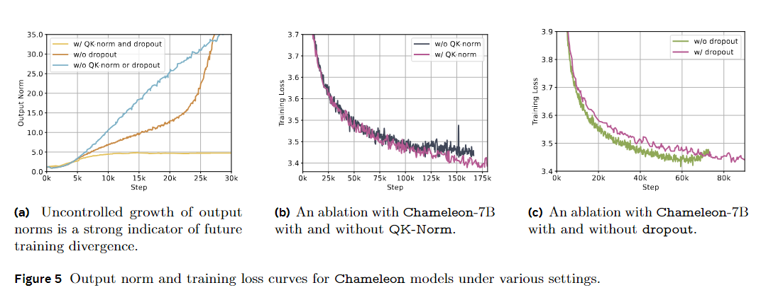
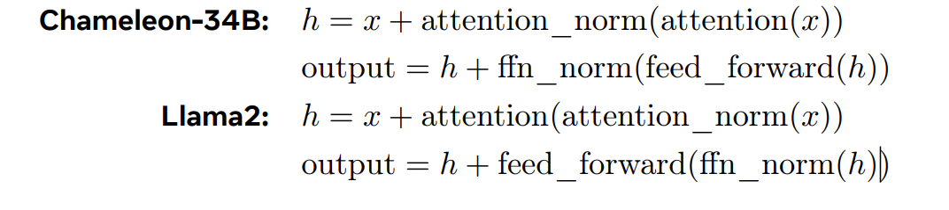
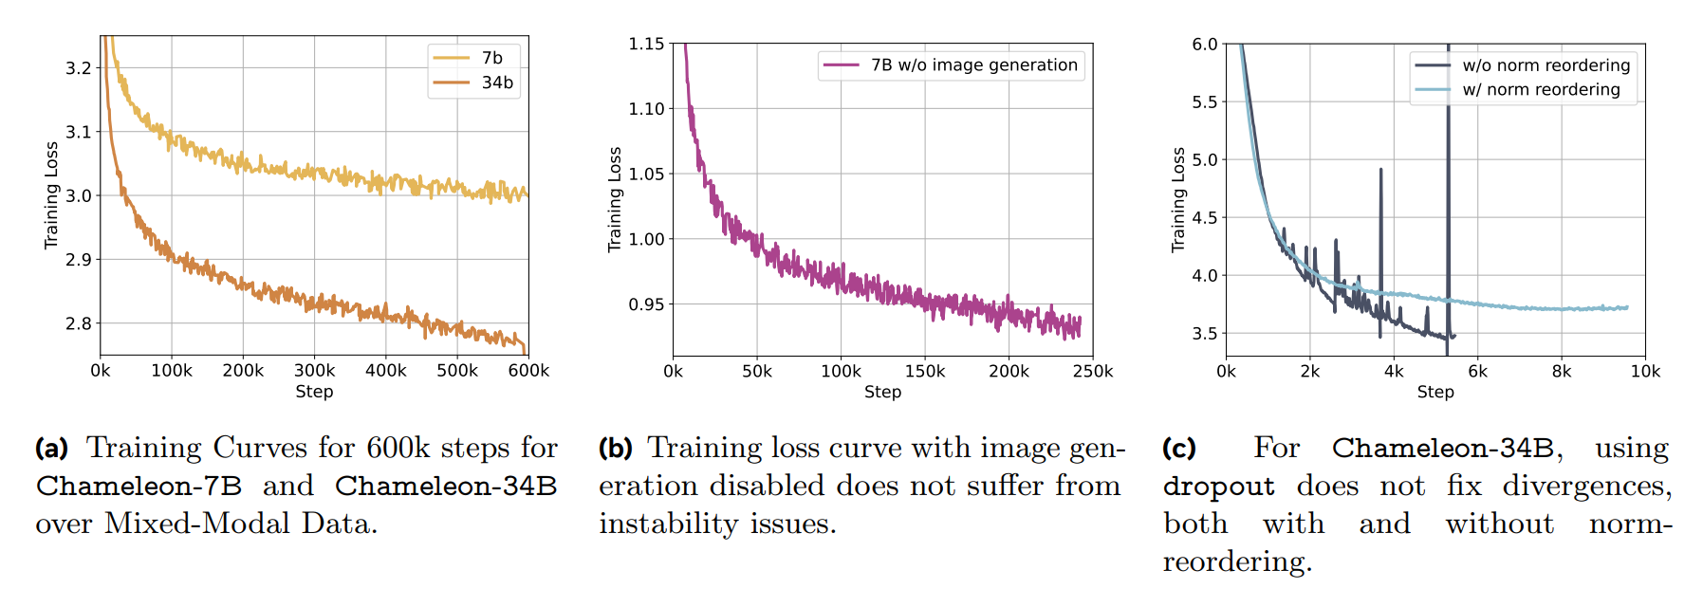
Chameleon
Stability
Query-Key Normalization (QK-Norm)
Re-ordering of Norms
z-loss regularization
Data balance
Inference
Autoregressive Generation
Masking for Modality-Constrained Generation
Fixed-Sized Text Units
Notes:
A shows the beginning of ...Qk norm drop out is important under various settings
Autoregressive Generation: token by token
Masking for Modality-Constrained Generation: for modality-constrained generation），Chameleon模型使用了 masking 技术。这意味着在 detokenization 过程中，模型会忽略不属于目标模态的tokens。
Fixed-Sized Text Units: Chameleon模型在token-based image generation produces fixed-size blocks of tokens corresponding to an image.

Slide 10
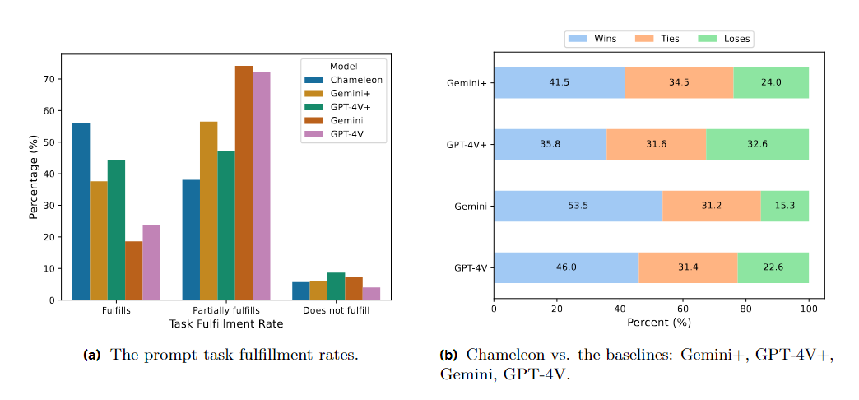
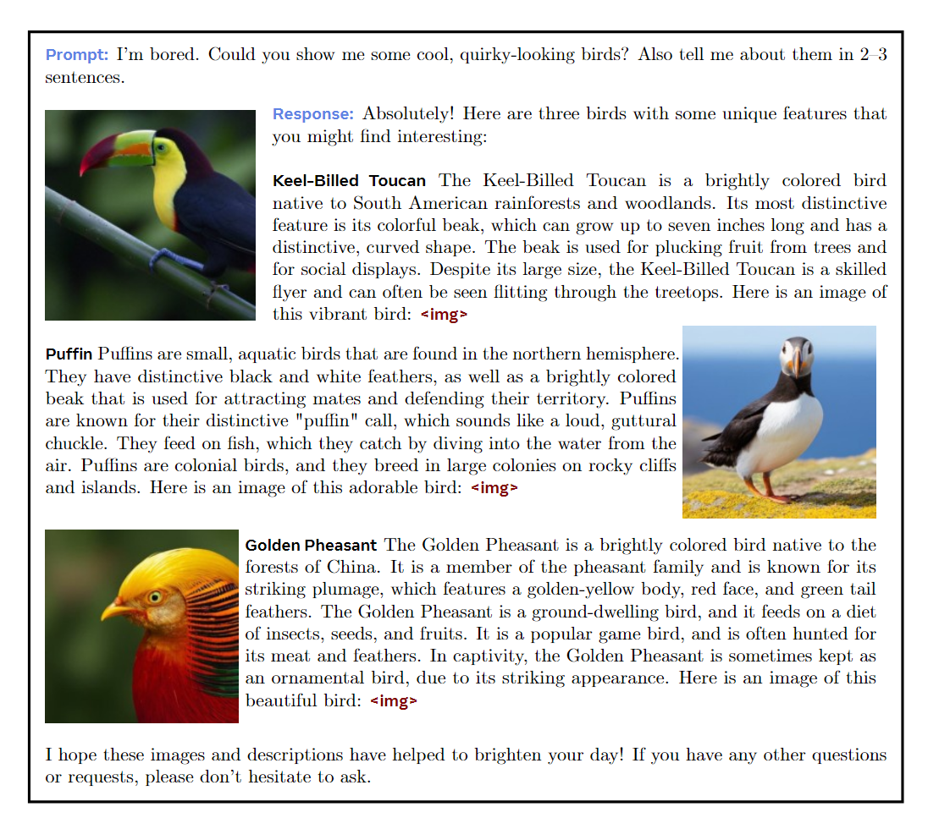
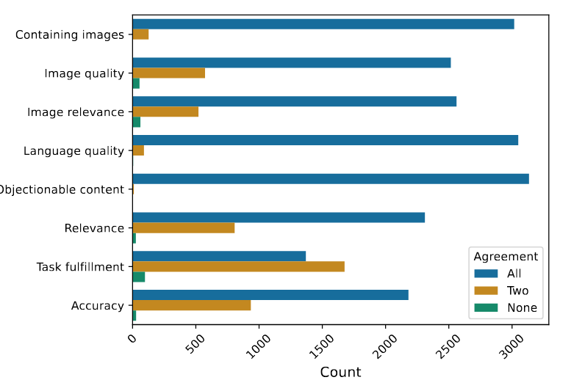
Chameleon
Notes:
we ask annotators whether the response fulfills, partially fulfills, or does not fulfill the task described in the prompt2
The win rate is calculated by adding 1 point for a win and 0.5 points for a tie.
To understand the quality of the human annotators and whether the questions we asked are reasonably designed, we examine the level of agreement between different annotators.
Right is a Sample interleaved image and text generation from Chameleon

Slide 11
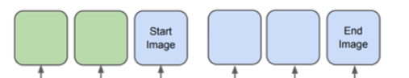
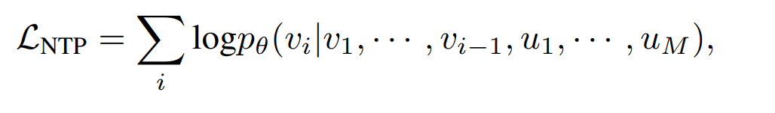
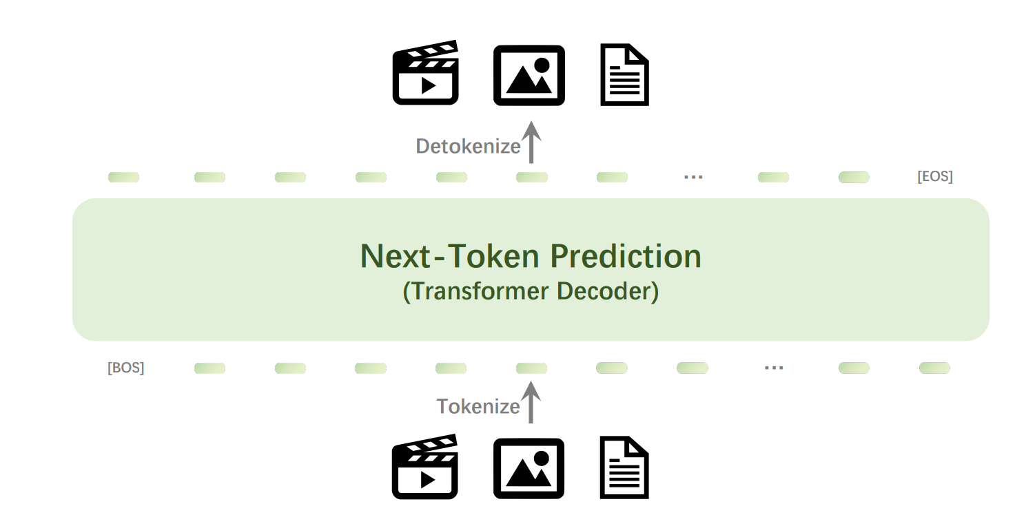
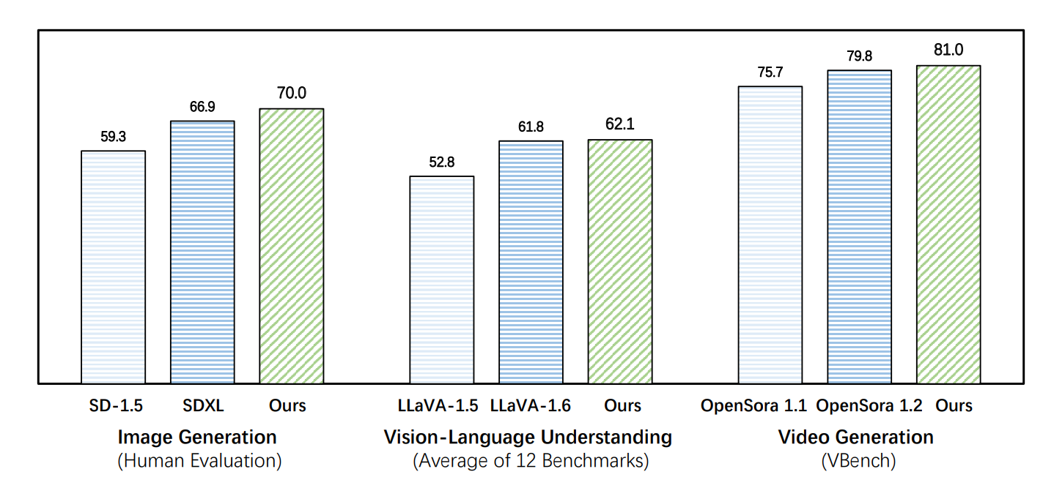
Emu3(BAAI)
Notes:
Emu3 is essentially an implementation of Chameleon that adds specific details to it. First, it extends Chameleon's capabilities by adding a video generation modality. Secondly, it emphasizes the importance of discrete properties, using only the next token loss. Finally, it thoroughly evaluates performance across different tasks.
Compared with the chameleon in the format of tokens [SOV] marking thestart of the vision input, [SOT] marking the start of vision tokens, and [EOV] indicating the end of the vision input. The “meta text” contains information about the resolution for images, and for videos, it includes resolution, frame rate, and duration, all presented in plain textformat. We also move the “caption text” field in a portion of the dataset to follow the [EOV] token,thereby constructing data aimed at vision understanding task

Slide 12
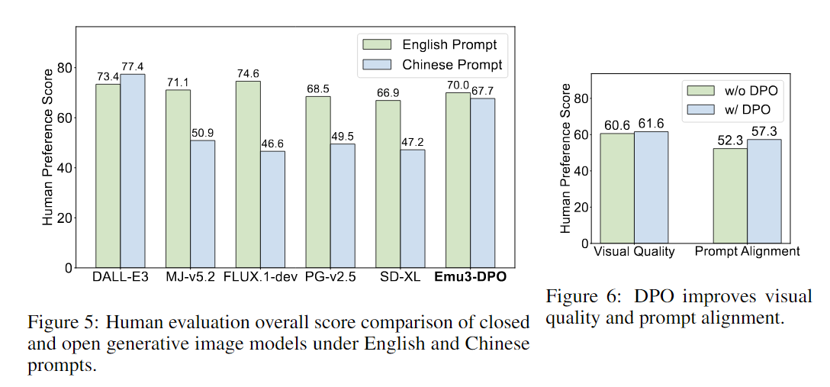
Emu3
Quality Fine-Tuning
vision generation tasks
512 pixels to 720 pixels
Direct Preference Optimization
Generate Initial Pool (8-10 inferences)
Evaluation(vision appeal & prompt alignment)
Create Triplets(p_i, x_chosen_i, x_rejected_i)
Understanding
&
Generation
Notes:
Emu3 and Chameleon have almost identical encoding settings and architecture, with the main difference being the fine-tuning techniques used. The image shows a comparison between the performance of Emu3-DPO with other generative models for both English and Chinese prompts. The left chart presents human preference scores across different models, indicating that Emu3-DPO achieves high scores, especially in comparison to some other models. The right chart highlights that Direct Preference Optimization (DPO) leads to improvements in visual quality and prompt alignment compared to not using DPO.
Emu3-DPO minimizes the DPO loss and the next token prediction cross-entropy loss to fine-tune the QFT model.

Slide 13
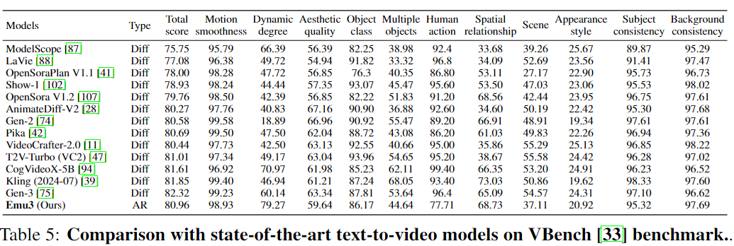
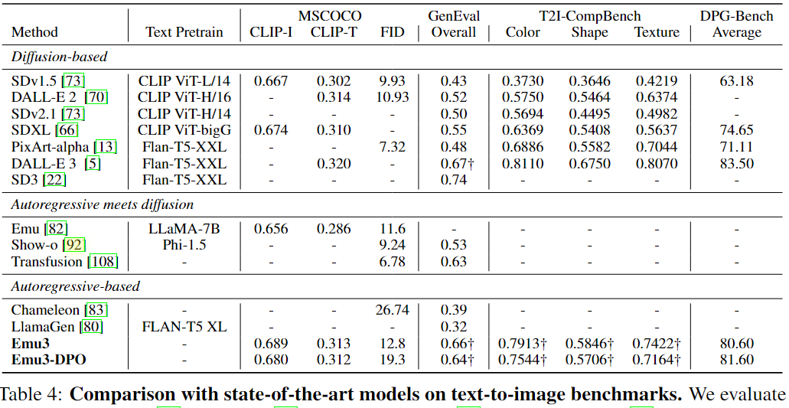
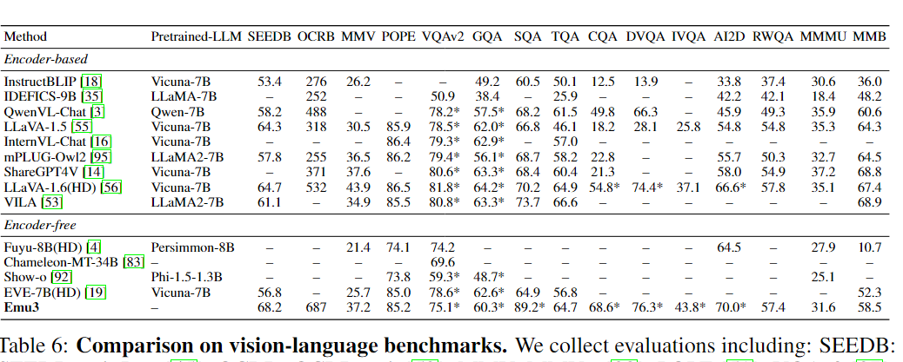
Emu3
Notes:
Emu3 addresses the experimental shortcomings of Chameleon, demonstrating that the model's capabilities are competitive with state-of-the-art (SOTA) models in these domains.
Encoder means if or not use pre-trained model like clip cause clip is expensive to train but most guys neglected this expense
In short, it's like using brute force—leveraging larger datasets and techniques to prove the feasibility of single-step next prediction and discrete encoding.

Slide 14
Outline
AR Based
Chameleon
Emu3
AR & Confusion Based
Transfusion
Show-o

Slide 15
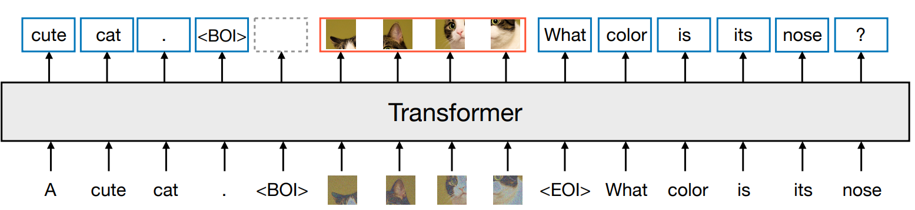
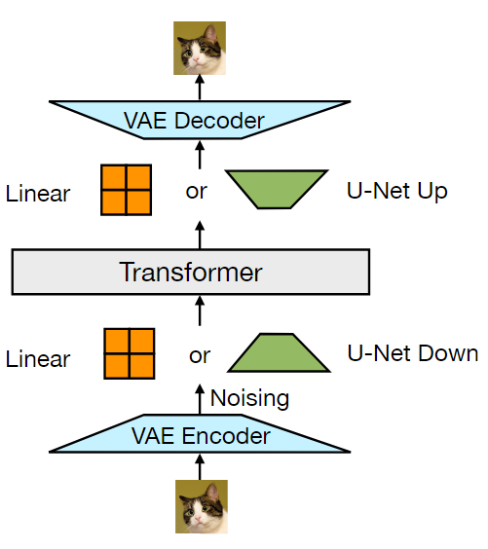
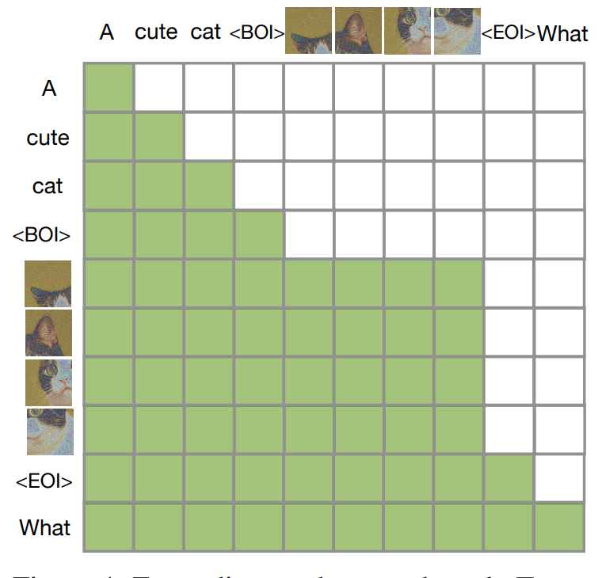
Transfusion
Continuous embedding
image -> vae encoder -> patches-> linear/u-net -> transformer -> linear/u-net -> patches> vae decoder -> image
Intra-image attention
Notes:
'Transfusion' uses a discrete autoregressive approach for text and a continuous diffusion method for image learning.
Discretization reduces the representation power, which often leads to performance degradation in multimodal understanding tasks. To address this, Transfusion proposes using continuous embedding to represent image input tokens.

Slide 16
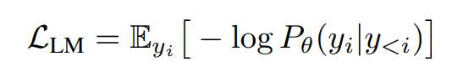
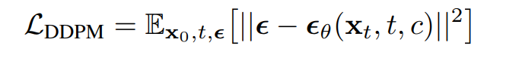
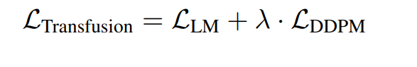
Transfusion
Inference
x_t-1 = x_t - transformer(x_t, t, current sequence of a mixture of tokens and images)
[x1 to xm, image1, y1 to yn, image2, ...]
[x1 to xm, image1, y1 to yn]
Notes:
从一个纯noice x_T出发，其形状为n个image patches，把这个x_T扔给transformer，并去噪T次。
每一步t，预测noise的量级（用transformer来预测，然后
x_t 去除预测出来的Noise两级，得到x_t-1。
然后x_t-1就覆盖掉x_t，进行下一步t-1的操作。
如此，就得到了x_0，是我们生成出来的image。
从上述训练目标可以看出，训练时对于文本来说需要每个token都计算对应的损失，而对于图像来说，是用整张图像token一起计算diffusion去噪loss。

Slide 17
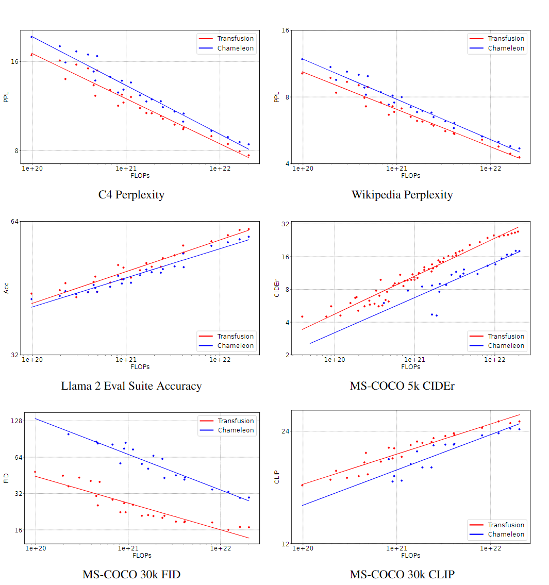
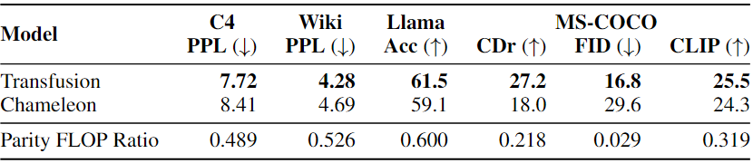
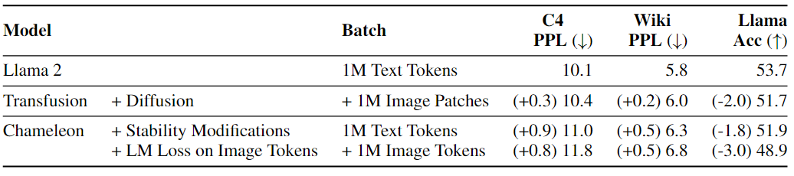
Transfusion
Experiments
Scaling(with Chameleon)
Text-Only performance(0.76B)
Notes:
Parity FLOP Ratio is the relative amount of Transfusion FLOPs needed to match the results of Chameleon 7B

Slide 18
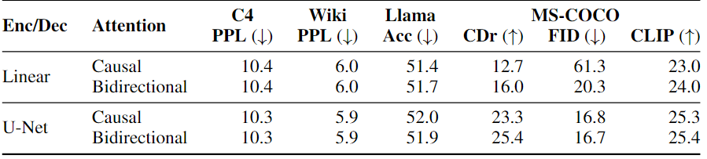
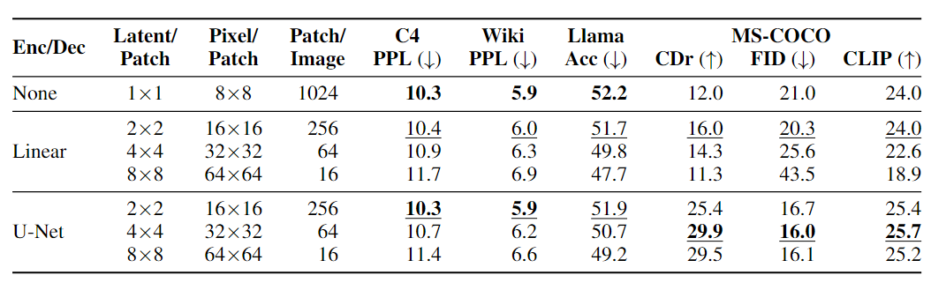
Transfusion
Attention Masking
Patch Size
Notes:
it is evident that the bidirectional attention mechanism is crucial. We can define the model on different sizes of latent pixel blocks; larger sizes require less computation, but text performance degrades as patch size increases. Additionally, the advantage of U-NET over the linear method increases with more parameters.

Slide 19
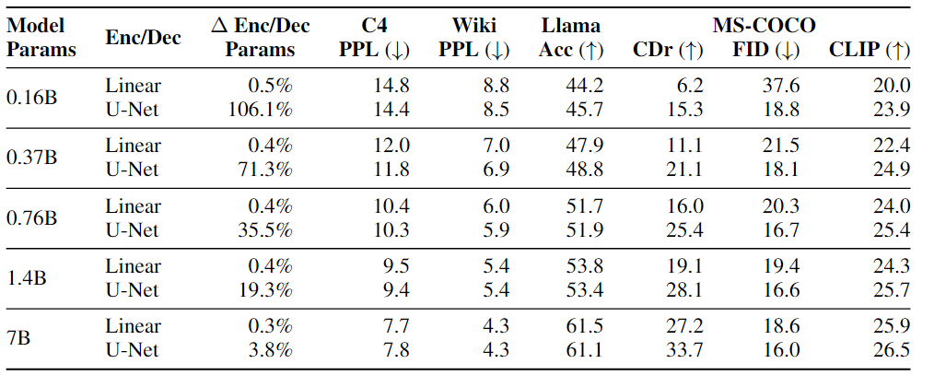
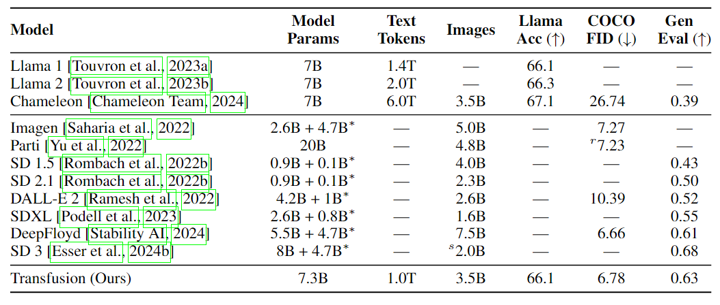
Transfusion
Performance
Linear VS U-Net

Slide 20
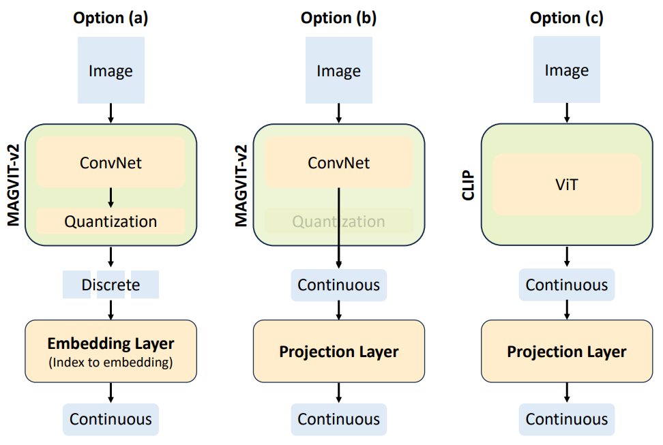
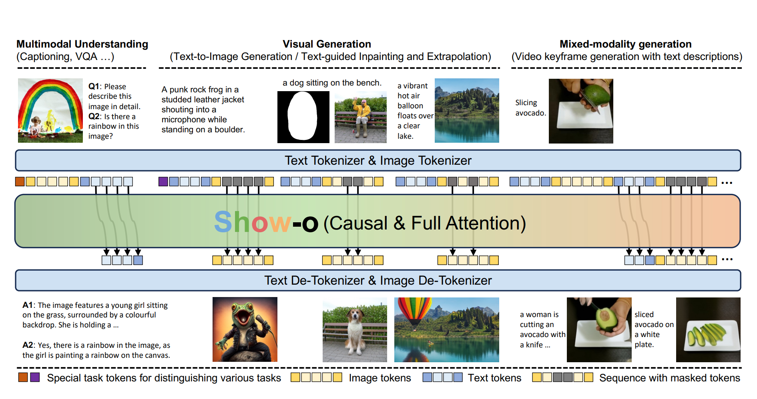
Show -o
Discrete diffusion/Masked AR?
Tasks Specialized token
Compare the performance of using discrete /continuous
Notes:
An overview of Show-o. The input data, regardless of its modalities, is tokenized and then prompted into a formatted input sequence. Show-o processes text tokens autoregressively with causal attention and image tokens in (discrete) denoising diffusion modeling via full attention, and then generates the desired output.生成式的掩码建模等价于discrete diffusion过程，因此跟随之前的MASKGIT生成式的掩码建模任务来进行图像生成的学习，等效于结合了diffusion来完成图像生成任务的学习。

Slide 21
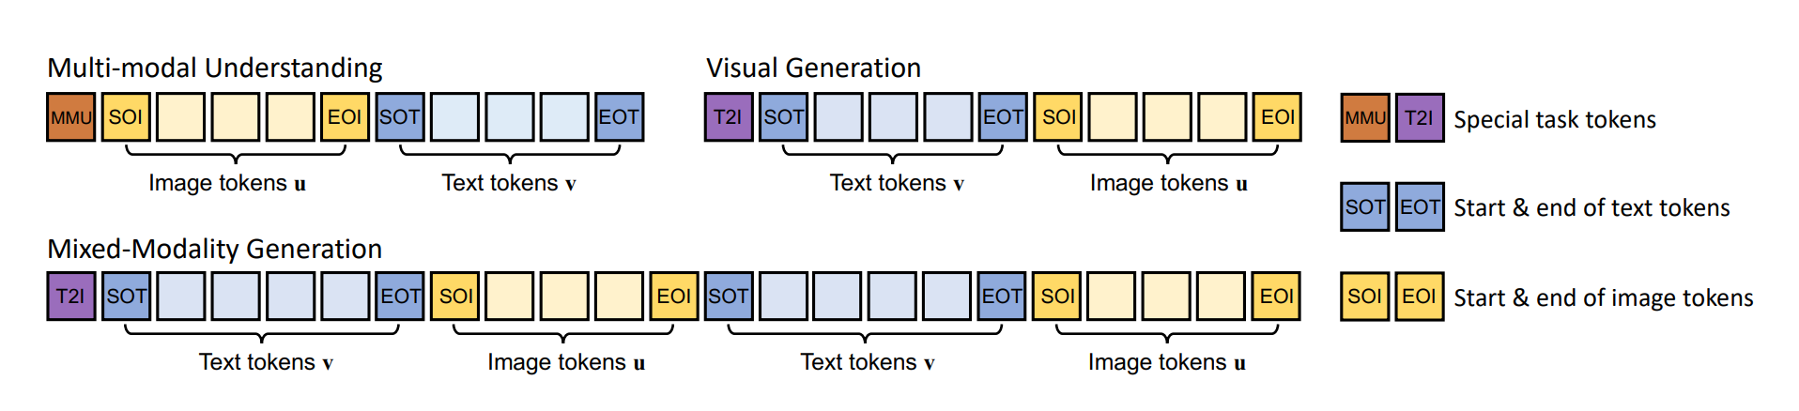
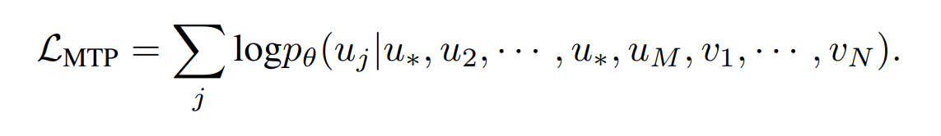
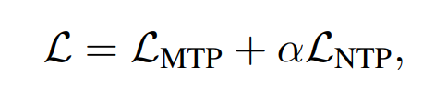
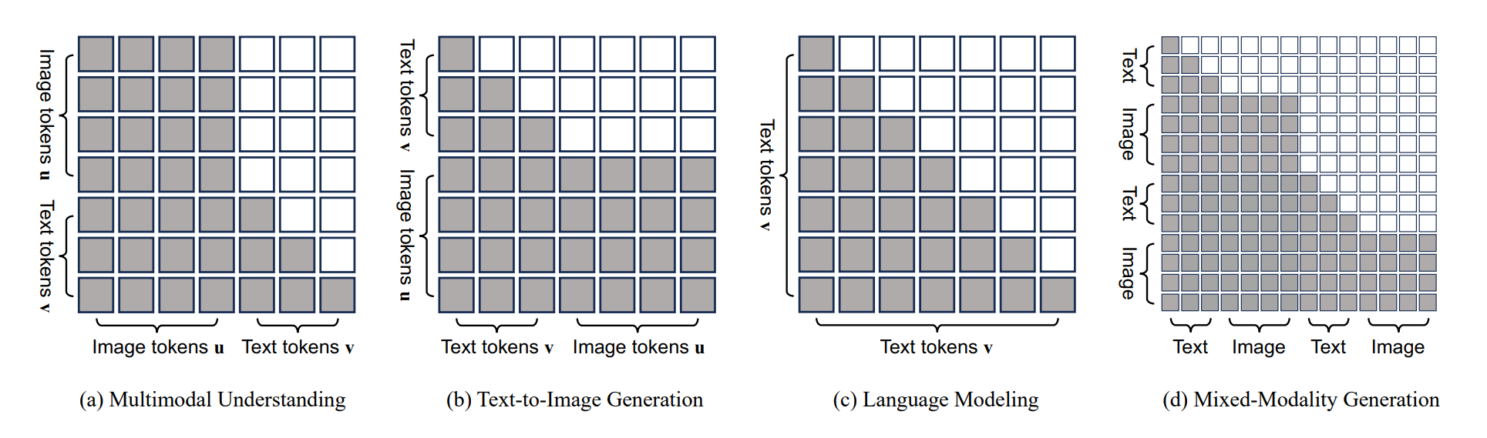
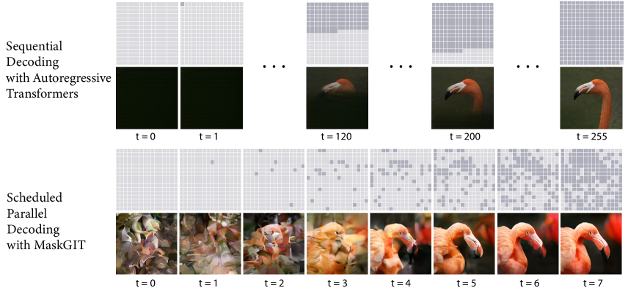
Show -o
Notes:
训练阶段主要包含三个过程，每个阶段任务的数据随机采样构成batch。
图像生成需要采用MaskGiT^{[6]}里的iterative decoding策略
感性地理解为一张空白图。然后每次迭代都对这些token并行预测出对应的概率分布，概率分布中每个位置代表visual vocabulary中的一个discrete embedding概率，对每个位置得到最大的概率值作为其置信度分数。挑选置信度分数最高的保留并重写，其余的保持mask状态，重新进行mask token的预测。
随机对图片token进行一定比例的mask，然后要求模型依据unmask image token和text token来完成对mask image token的重建

Slide 22
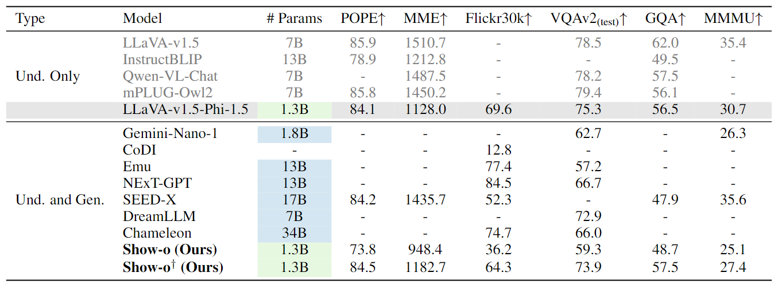
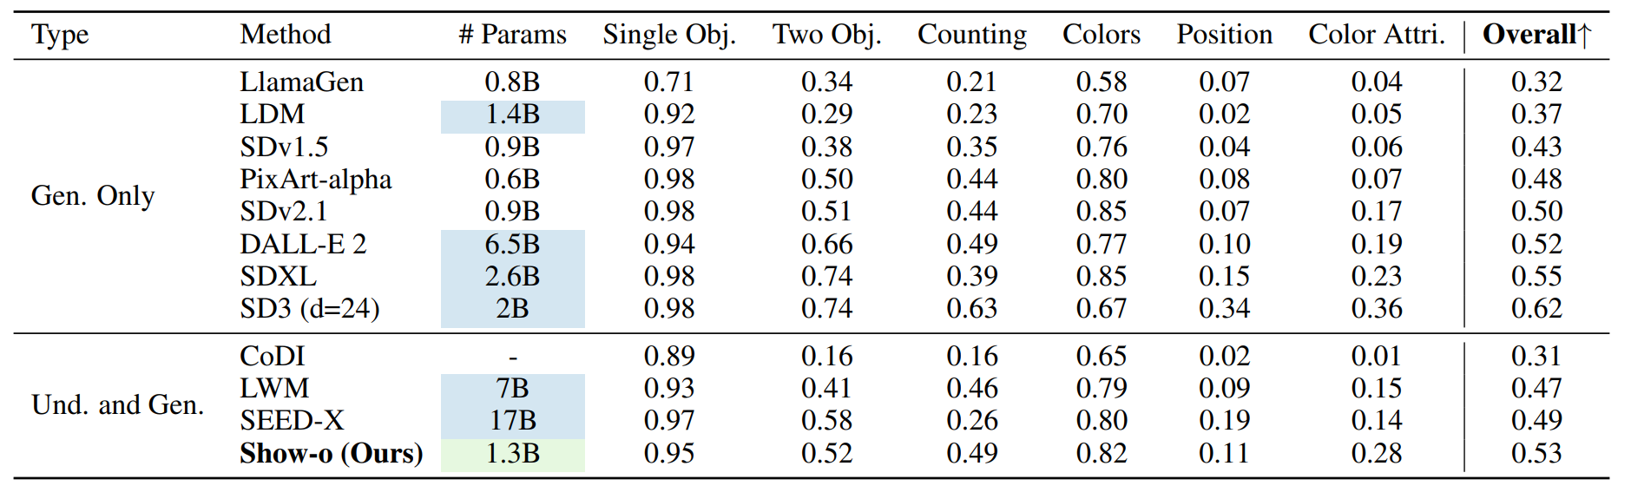
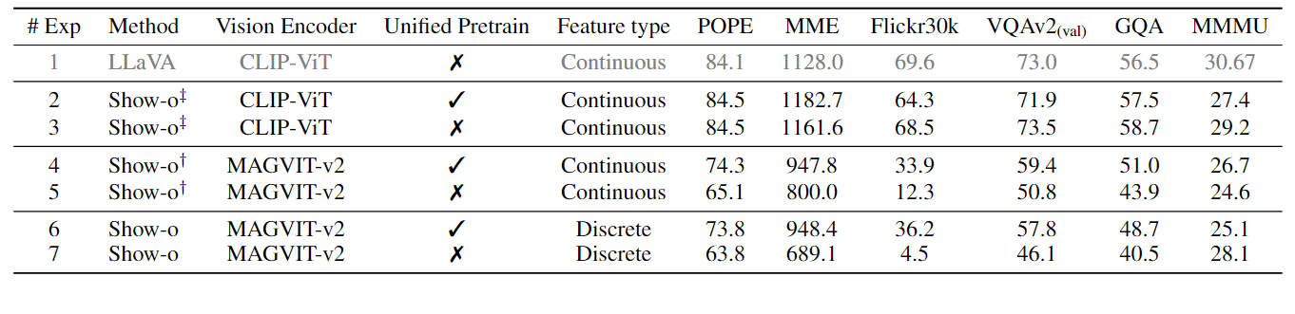
Show -o
Notes:
Performance on multimodal understanding benchmarks and text-to-image generation
† denotes the improvedShow-o that employs CLIP-ViT continuous representations.
Unified pretrain is a kind of alignment
It investigate the encoder type’s influence on the performance of understanding tasks cause the generation task is ...
Exp 2, 3 vs. Exp 4, 5: One reason for the lower performance of MAGVIT on understanding tasks compared to CLIP-ViT could be the visual representation training tasks, and another could be the dataset size (35M vs. 400M).
Exp 4 vs. 6 and Exp 5 vs. 7: The continuity or discreteness of visual representations may not be as important for understanding tasks. Instead, a well-designed visual representation task and large-scale scaling seem to be key factors for solving image understanding.

Slide 23
Conclusion
Transfusion
Vs
Show-o
Features loss(continuous)
Foundation model
Better performance
GIT based(discrete)
Format Based
Less resource
Notes:
Transfusion更偏向于从混合模态序列中从头学习一个基座模型。而Show-o更像是在为预训练好的语言基座模型进行微调以配备图像理解和生成能力，旨在统一不同任务，所以有专门设计的input format，调用模型不同功能来分别完成理解和生成任务。
弱点是生成预训练没有显著促进理解。visual self-supervision

Slide 24
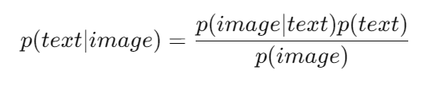
Conclusion
Transfusion
Vs
Show-o
Features loss(continuous)
Foundation model
Better performance
GIT based(discrete)
Format Based
Less resource
Autoregressive Image Generation without Vector Quantization
2406.11838 (arxiv.org)
Notes:
The core of this model is still autoregressive (AR), where AR models the conditional probabilities p(image|text) and p(text|image). According to Bayes' theorem. The key is p(image), which represents visual self-supervised learning.
Kaiming He has already attempted this field. Due to limited time, I haven't been able to read it yet. If you're interested, you can check it out.

Slide 25
Discussion

